Slide 1
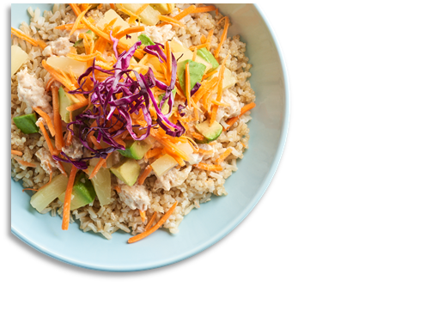






District Logo
May 2025
CAM MIDDLE SCHOOL
MENU
 | MON |  | TUES |  | WED |  | THURS |  | FRI
 |  |  |  |  |  | 1 |  | 2
5 |  | 6 |  | 7 |  | 8 |  | 9
12 |  | 13 |  | 14 |  | 15 |  | 16
19 |  | 20 |  | 21 |  | 22 |  | 23
26 |  | 27 |  | 28 |  | 29 |  | 30
Chicken & Cheese Biscuit
A. French Toast w/ Sausage Patty
B. Grilled Chicken SDW
C. Meat Lovers Pizza
Sausage & Cheese Biscuit
A. Italian Dunkers
B. Tater Tot Beef Nachos
C. Variety Pizza
Ham, Egg & Cheese Muffin
A. Mini Corn Dogs
B. Bosco Sticks
C. Cheese Pizza
Cherry Frudel
A. Beef Nachos
B. Chicken Nuggets
C. Pepperoni Pizza
Homemade Breakfast Pizza
A. Country Popcorn Chicken Potato Bowl
B. Mc. Ribb
C. Sausage Pizza
Egg & Cheese Bagel Melt
A. Pancakes w/ Egg Patty
B. Chicken Tenders
C. BBQ Chicken Pizza
Lumberjack
A. Cheesy Baked Penne Pasta
B. Corn Dog
C. Variety Pizza
Offered Daily @ Breakfast
Fresh Fruit
1% White Milk
Chocolate Milk
100% Fruit Juice
Assorted Cereals w/ Graham Crackers
Egg & Cheese English Muffin Melt
A. Pretzel w/ Cheese Sauce
B. Popcorn Chicken
C. Cheese Pizza
Country Sausage Gravy w/ Biscuit
A. Bosco Sticks w/ Sauce
B. Mini Corn Dogs
C. Pepperoni Pizza
Homemade Breakfast Pizza
A. BBQ Rib
B. Chicken Tenders
C. Sausage Pizza
Sausage & Cheese Bagel Melt
A. Donut w/ Egg Patty
B. Pulled Pork SDW
C. Meat Lovers Pizza
Ham, Egg & Cheese Muffin
A. Mac & Cheese
B. Sloppy Joe
C. Variety Pizza
Offered Daily @ Lunch
1% White Milk
Chocolate Milk
Cheese & Pepperoni Pizza
Cheeseburger
Chicken Sandwich
Spicy Chicken Sandwich
Sun Butter & Jelly Sandwich
Salad options
Tots or Fries
Variety Breakfast
A. Chef Pam’s Choice
B. Chef Heather’s Choice
C. Variety Pizza
Variety Breakfast
A. Salisbury Steak
B. Corn Dog
C. Cheese Pizza
Variety Breakfast
A. Chef Mandy’s Choice
B. Cheese Dog
C. Pepperoni Pizza
Variety Breakfast
A. Chef Andrea’s Choice
B. Chef Connie’s Choice
C. Variety Pizza
* Bread is offered with Salads
Menus are subject to change.
All Lunches Must Include Choice of:
Fruits and/or
Vegetable
And May Include:
1% Low-Fat White or Chocolate Milk
This institution is an equal opportunity provider.

